Slide 1
Exam results analysis
Data mining project

Slide 2




Our team
Sultan Kamliyev
Dias Kosmagul
Daulet Seitzhaparov
Team Lead
Senior Developer
Team Spirit Keeper

Slide 3
Mission statement
Classify students into ranks using their results

Slide 4
Using materials
Jupyter
Kaggle
Stack overflow
Useful notebook that is really comfortable for work with datasets
Open platform that consists many datasets
question and answer website for professional and enthusiast programmers

Slide 5
Used materials
Basic | Libraries
Python | Seaborn | Numpy
Statistics | Matplotlib | Sklearn
Machine learning | Pandas

Slide 6
Few words about dataset
The dataset includes scores from three exams and a variety of personal, social, and economic factors that have interaction effects upon them.
Exams are:
Mathematics
Reading
Writing

Slide 7
1,000
Number of students

Slide 8
Dataset info
Gender = Gender
Ethnicity = Group
Parent education = Parental degree of education (college, bachelor, master etc.)
Lunch = Did the student get lunch before exams
Preparation = Did students complete preparation for the exams
Math = Result for math exam
Reading = Results for reading exam
Writing = Results for writing exam

Slide 9
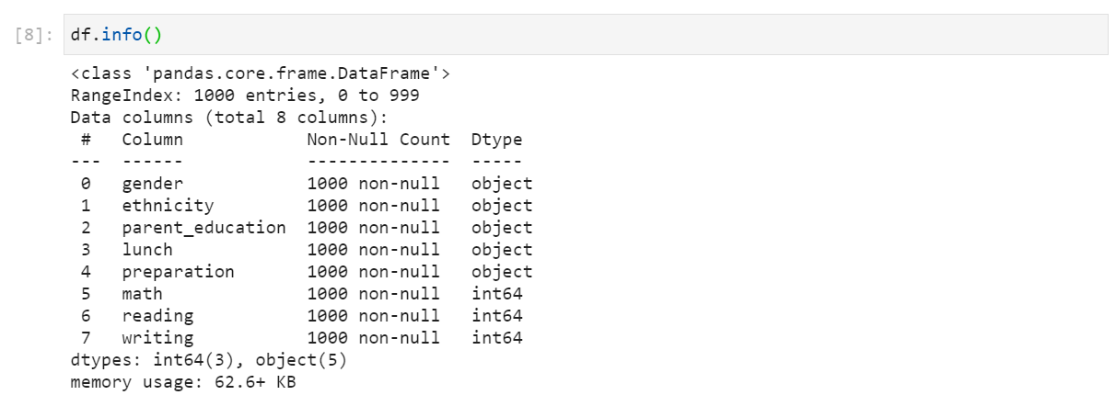
Dataset info

Slide 10
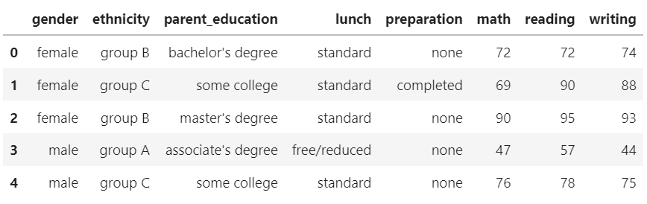
Dataset head

Slide 11
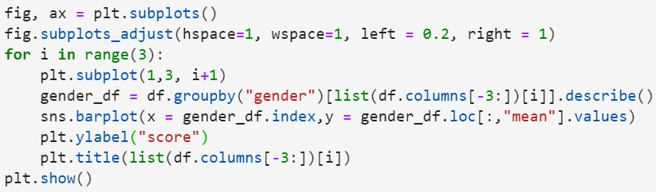
Performance for each field by gender

Slide 12
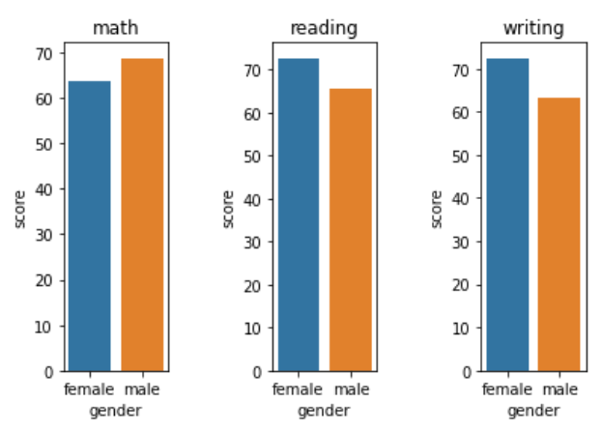
Performance for each field by gender

Slide 13
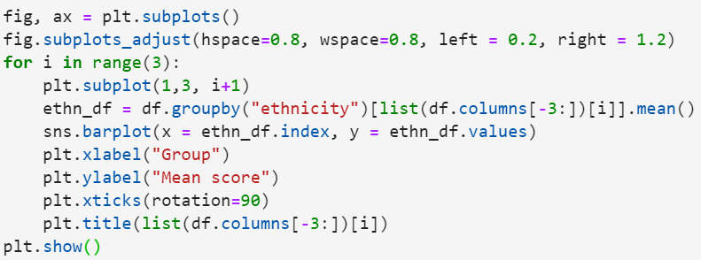
Performance of each group

Slide 14
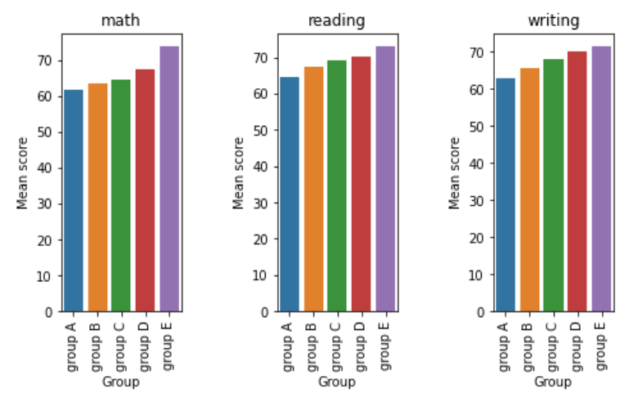
Performance of each group

Slide 15
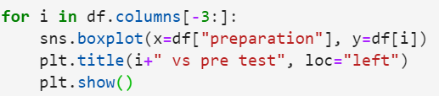
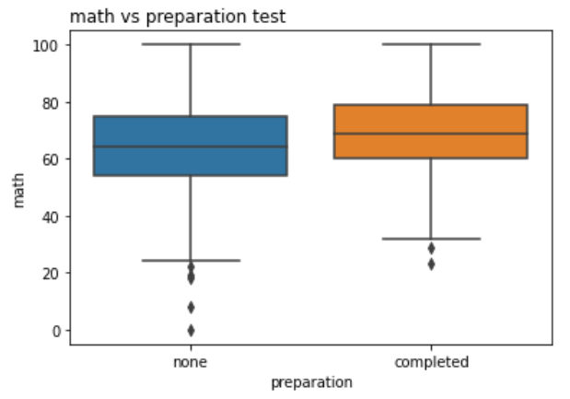
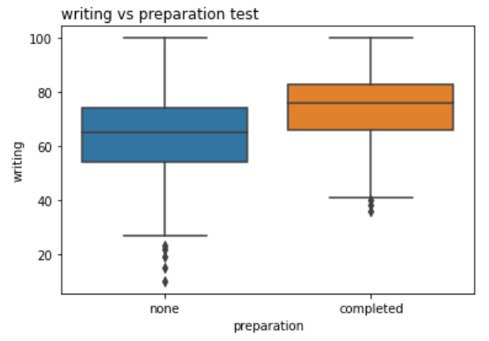
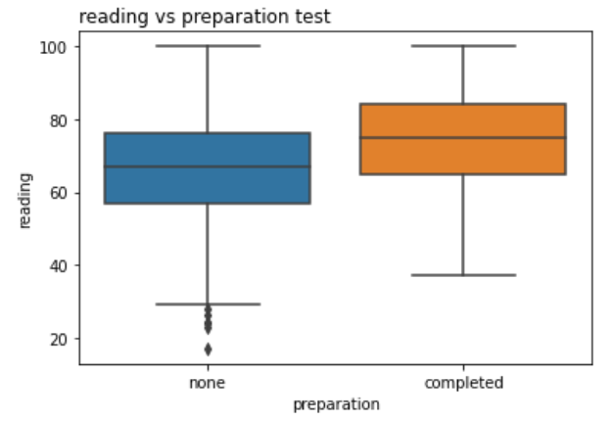
Comparison results and preparation

Slide 16
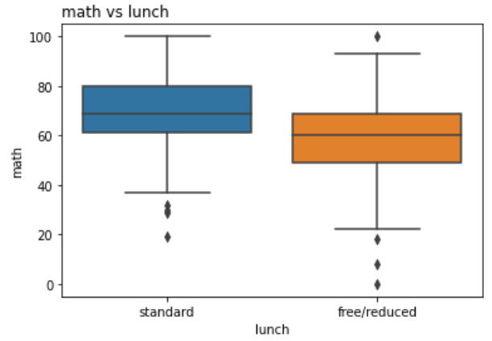
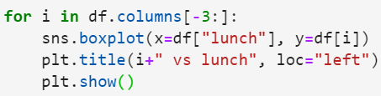
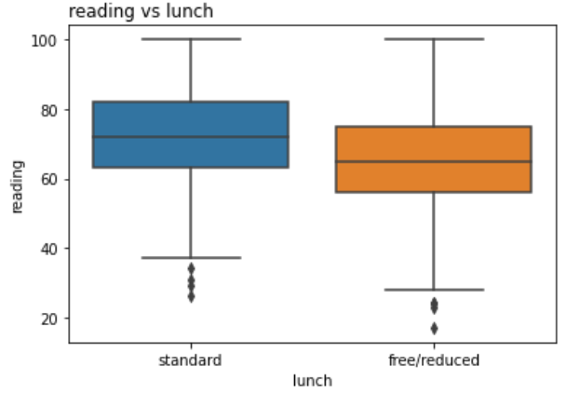
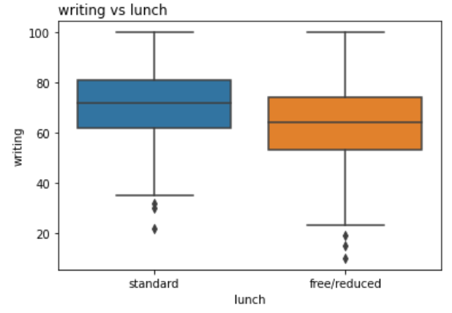
Comparison results and lunch

Slide 17
02
K-Means Clustering

Slide 18

What is Clustering?
Clustering loosely defined as groups of data objects that are more similar to other objects in their cluster than they are to data objects in other clusters. Clustering helps identify two qualities of data:
Meaningfulness
Usefulness
Examples:
Partitional clustering
HIerarchical clustering
Density-based clustering

Slide 19
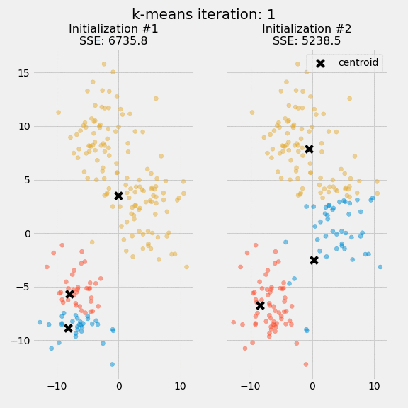
K-Means Clustering
K-Means Clustering method is an unsupervised machine learning technique used to identify clusters of data objects in dataset. K-Means is one the oldest and most approachable. So these traits male implementing k-mean clustering in Python reasonably straightforward.
SSE an measure of clustering performance
The first step is randomly select k centroids, where k is equal to the number of clusters of your choose. Centroids are data points representing the center of a cluster. Initialization of the centroids is an important step.
Expectation - Maximization

Slide 20
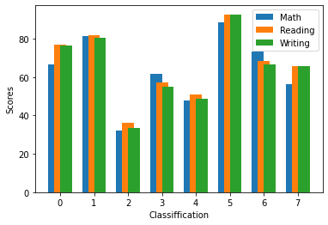
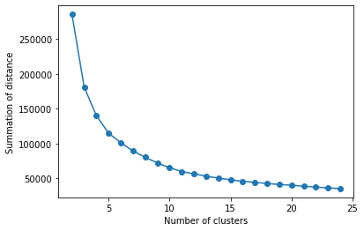
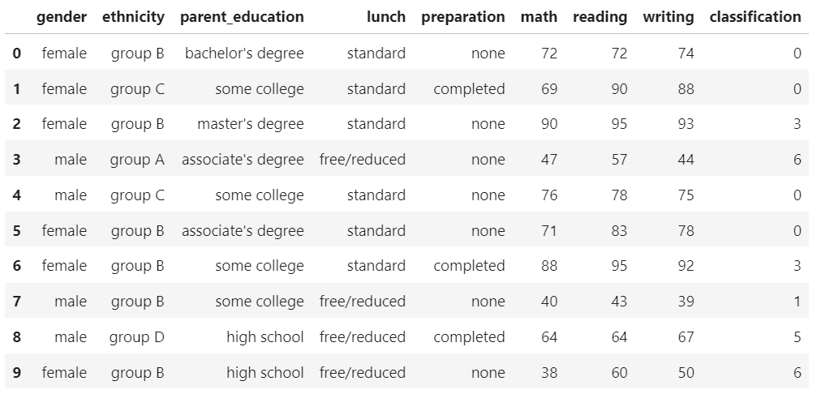
Analysis and Graphs

Slide 21
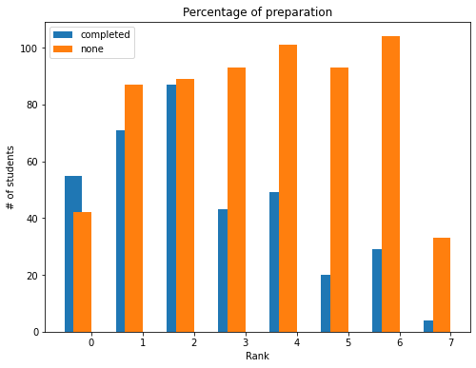
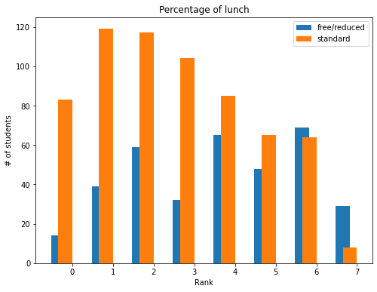
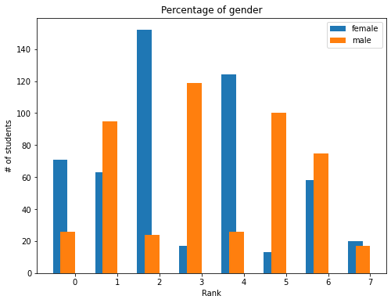

Slide 22
Conclusion
Education from parents can be helpful, but we can't count it as the most important
Сompleting the entire course is very important
One of the most significant things to the students is the lunch
it doesn't matter who you are, a girl or a boy. the effect on correlation is zero
in the end, we want to note that in order to get a good grade for a student, it is important to eat well and study carefully

Slide 23
Questions

Slide 24
Resources
Dataset: http://roycekimmons.com/tools/generated_data/exams/
Pandas: https://pandas.pydata.org/
Numpy: https://numpy.org/
Sklearn: https://scikit-learn.org/stable/
Seaborn: https://seaborn.pydata.org/
Matplotlib: https://matplotlib.org/

Slide 25
Thanks!

